Slide 1
Predicting Loan Default
- Yang (Stefan) Lyu

Slide 2






Project Outline
Company Introduction
Feature Engineering
Data Preprocessing
Model Building/Evaluation
Exploratory Data Analysis
Recommendation

Slide 3


Largest p2p lending platform
Head-quartered in San Francisco
Issued more than 10 billion by 2015
Loans between $1,000 to $40,000

Slide 4
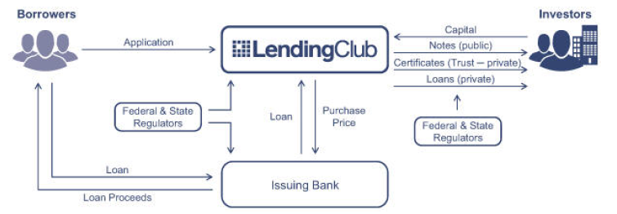
Business Model
Source: https://www.hbs.edu/openforum/openforum.hbs.org/challenge/understand-digital-transformation-of-business/business-model/lending-club-opening-the-floodgates-on-credit/comments.html

Slide 5
Objective
Problem: Potential default risk
Solution: Machine learning models to predict default
Data:
All transactions issued between 2012 and 2013
188,183 rows and 145 features
108 numerical variables and 37 categorical variables

Slide 6




Data Description
Credit History
Number of open accounts,
Credit inquiries, delinquency, total credit revolving balance, total credit limit, etc
User Info
State, employment length,
employment title,
annual income, dti, zip code,
home ownership, member id, etc
Loan Info
Application type, description, purpose,
grade, interest rate, term, issue date,
loan amount, funded amount, etc
Payment Info
Last payment date, last payment amount,
interest, late fee, principal received to date,
etc.

Slide 7
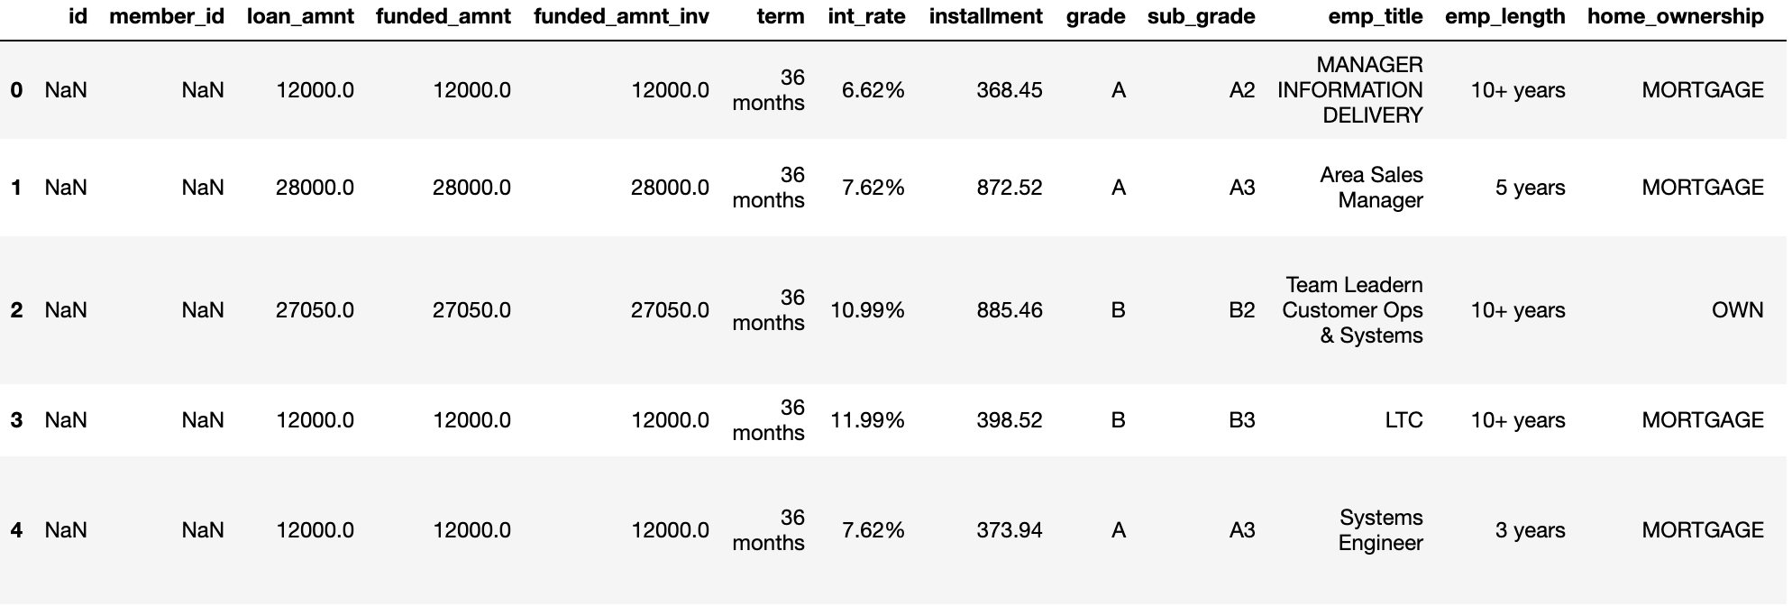
A peak at the data

Slide 8
Data Preprocessing
Completeness
Missing/Null value
Data types, syntax, definition
Duplicates
Uniqueness
Validity

Slide 9
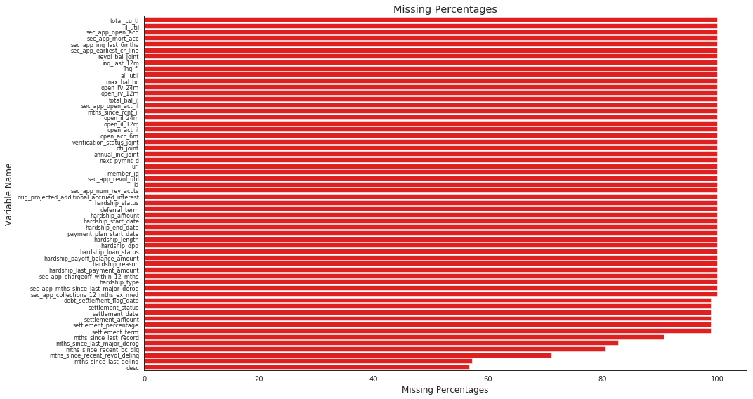
Completeness – Missing > 50%
Missing suggest no delinquency records, convert to categorical variable

Slide 10
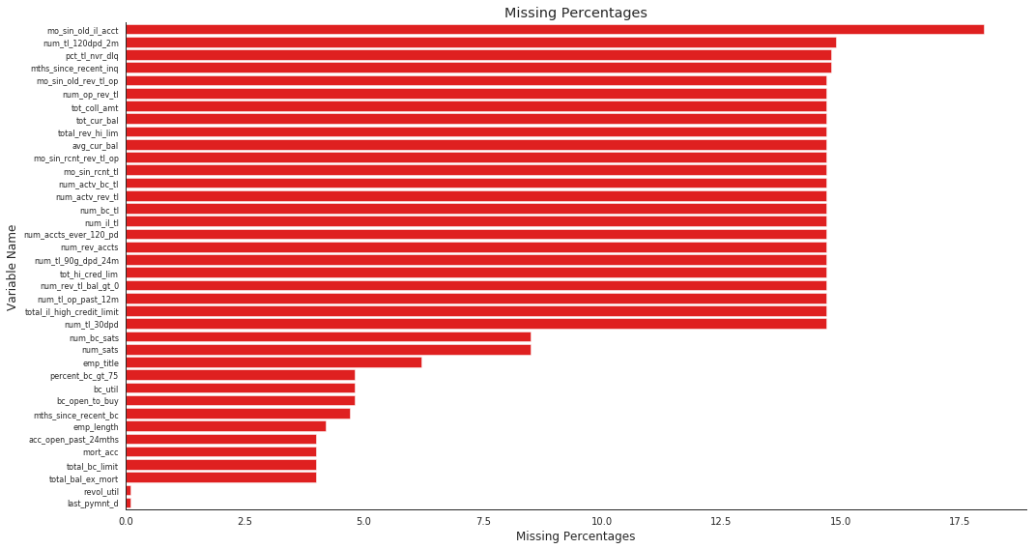
Missing < 50%

Slide 11
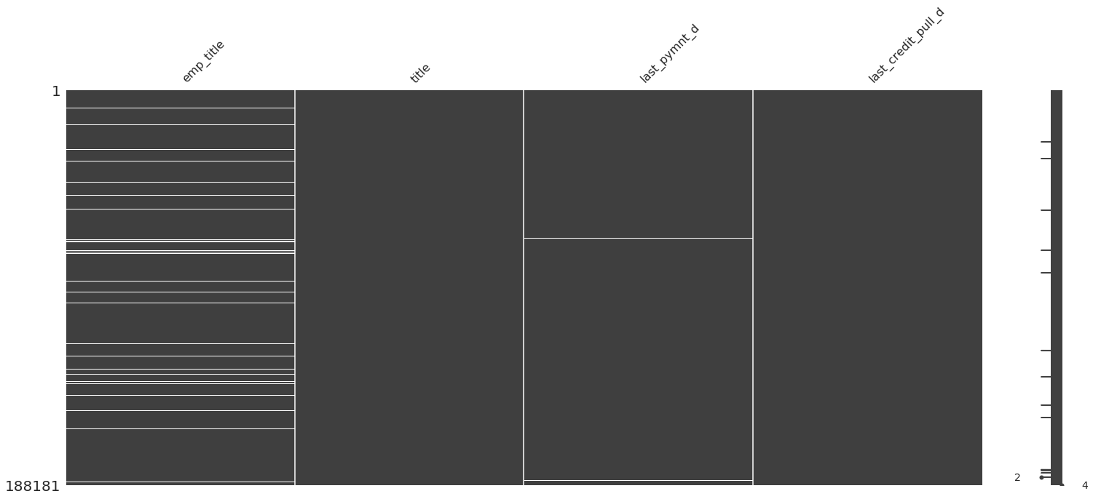
Missing - Categorical
Few observations missing – remove rows with missing in last payment date and last credit pull
Ignore missing in employment title and title

Slide 12
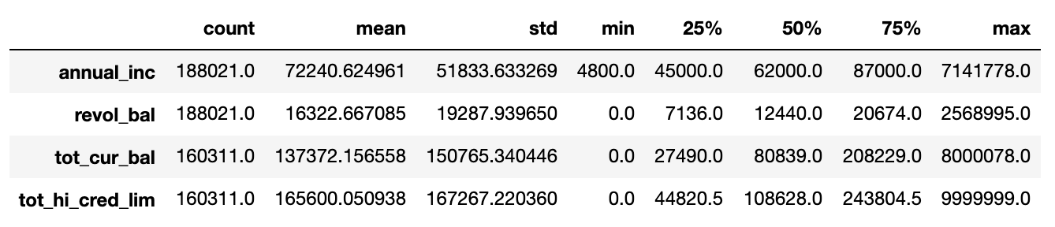
Missing - Numerical
Remove outliers > 4 standard deviation of median
Impute ordinal variables with median
Impute numerical variables with mean

Slide 13
Uniqueness
Columns to check
Loan amount
Term
Interest Rate
Grade
Employment length
There are no duplicated records
Home ownership
Issue date
Purpose
Zip code

Slide 14
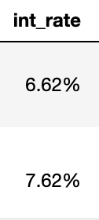
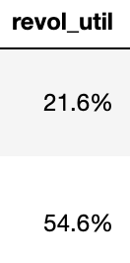
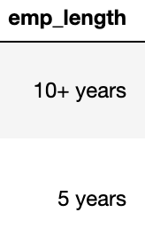
Validity
Convert data types
Convert to datetime object
Issue date, earliest credit line, last payment date, last credit pull date
Drop features
Title, employment title, zip code, debt settlement flag

Slide 15
Exploratory Data Analysis
Univariate
Analyze a single variable
Multivariate
Analyze relationships between variable of interest

Slide 16
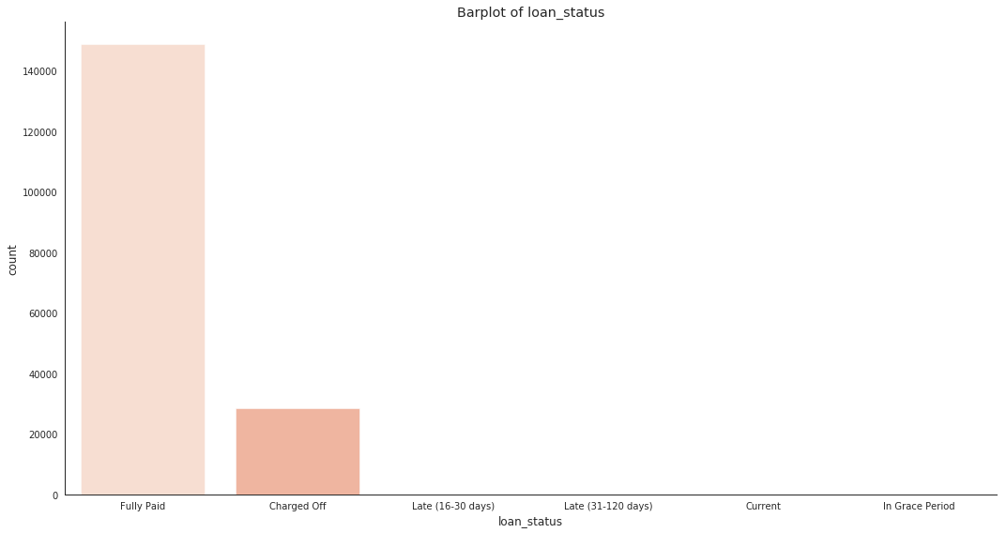
Univariate – Loan Status
Coded as default(1)
Drop

Slide 17
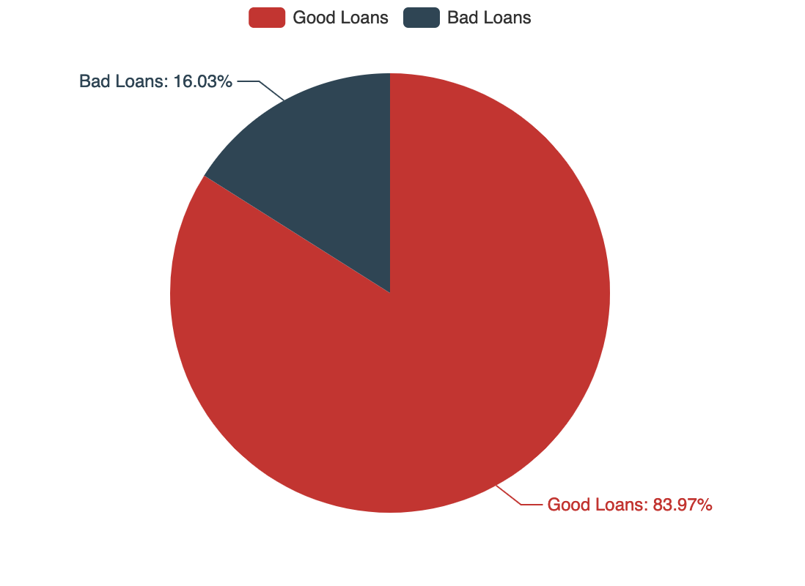
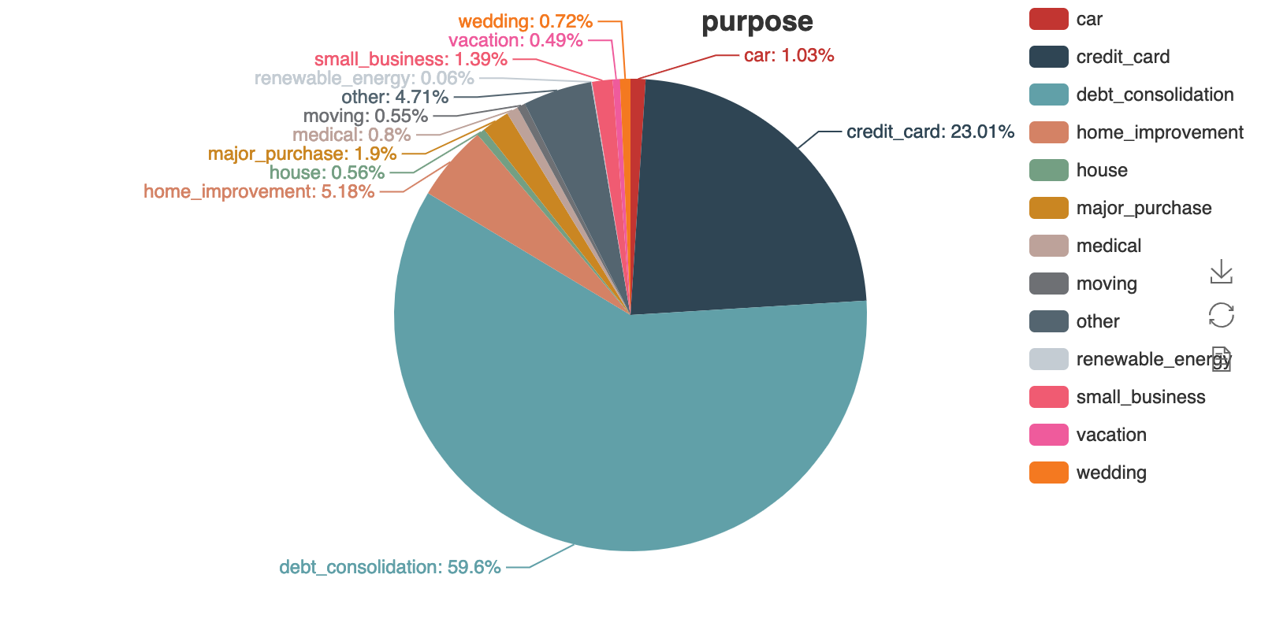
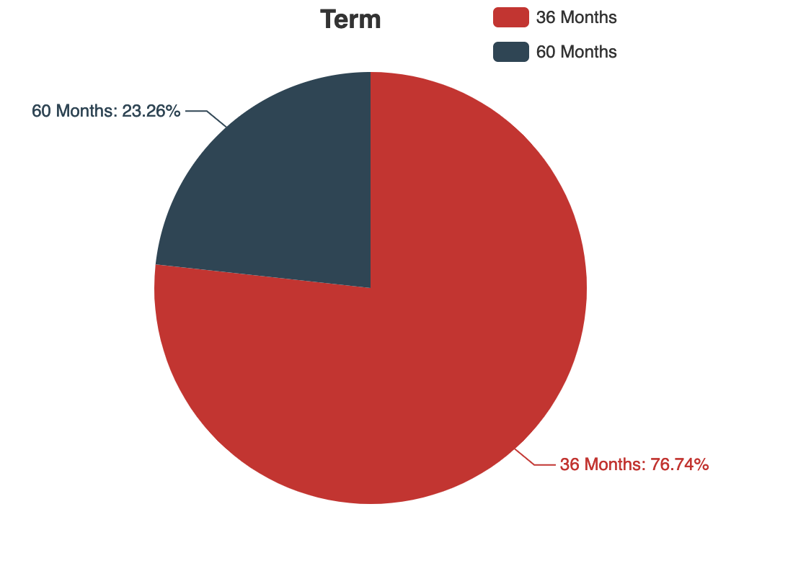
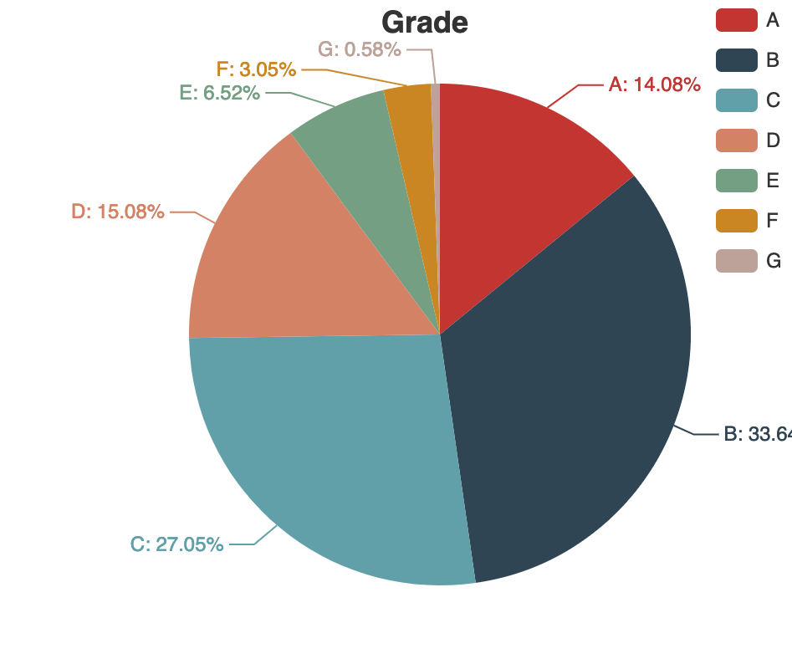

Slide 18
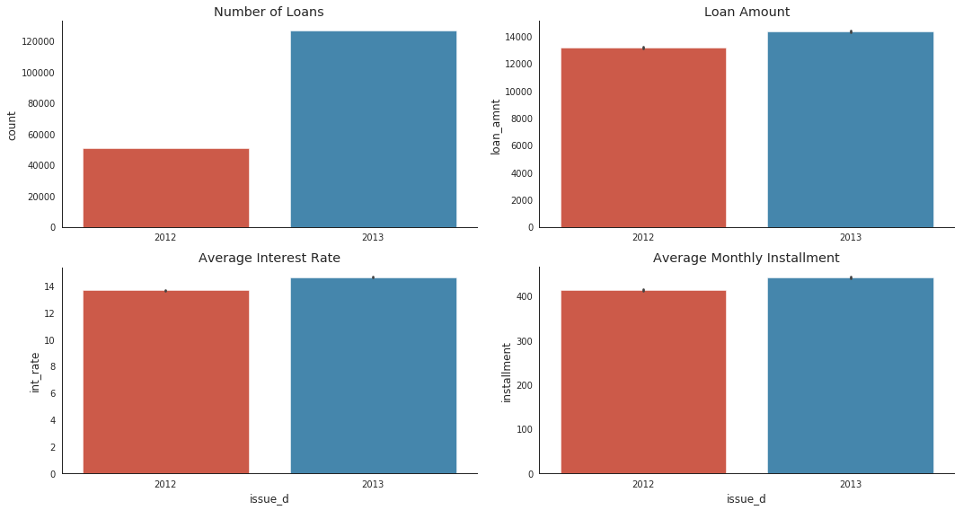
Multivariate

Slide 19
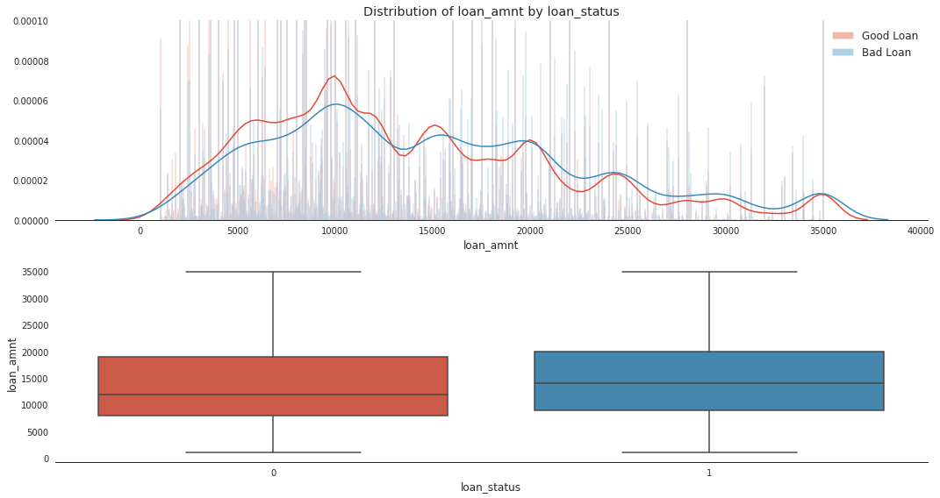
Loan amount by Loan Status

Slide 20
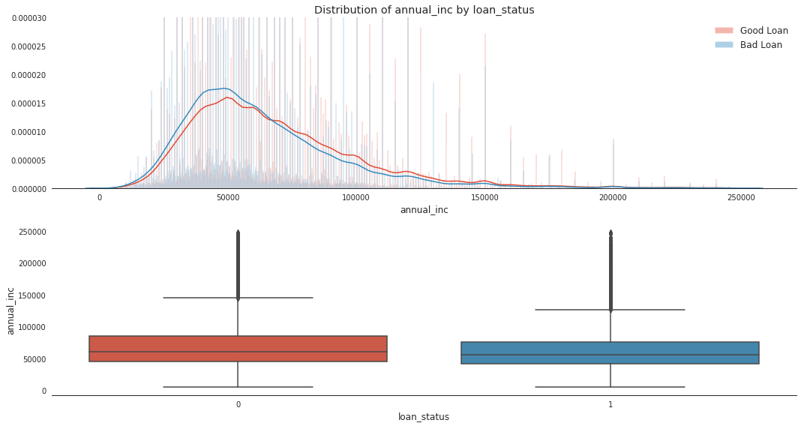
Annual Income by Loan Status

Slide 21
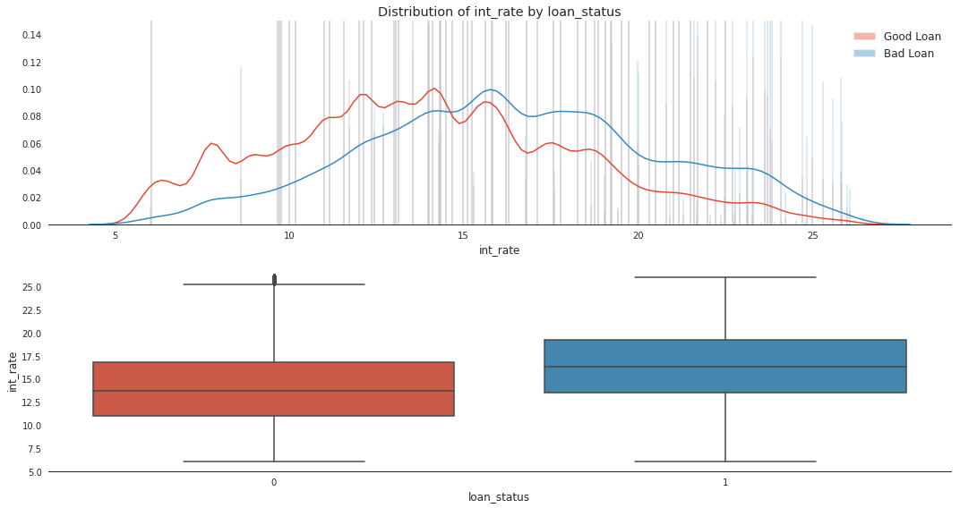
Interest Rate by Loan Status

Slide 22
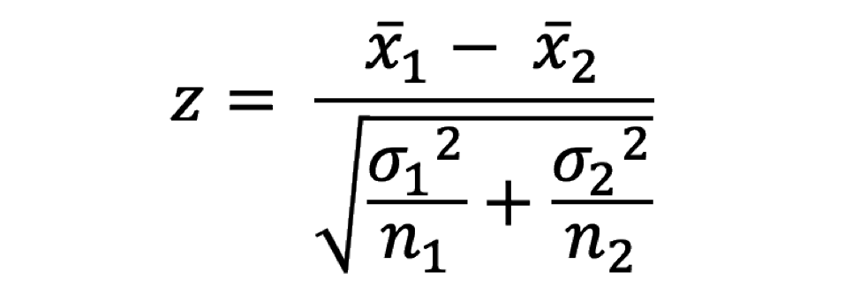


Two-sample Z-test
Test for difference in mean
$$H_{0}:µ_{1}=µ_{2}$$
$$H_{1}:µ_{1}≠µ_{2}$$

Slide 23
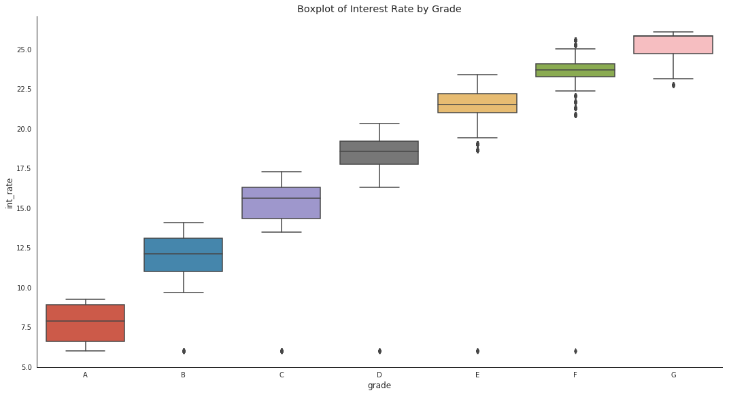
Interest Rate by Grade

Slide 24
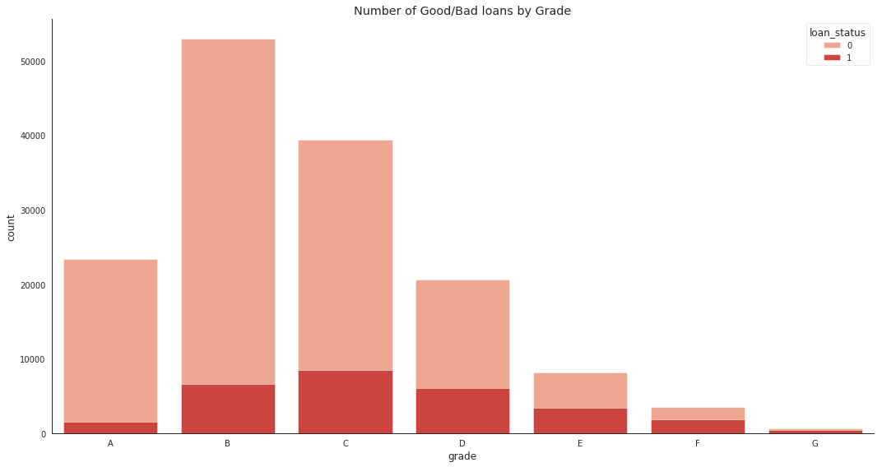
Grade by Loan Status

Slide 25
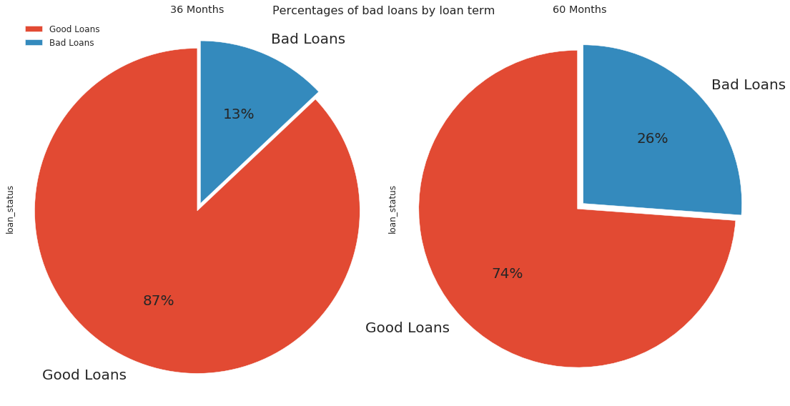
Term by Loan Status

Slide 26
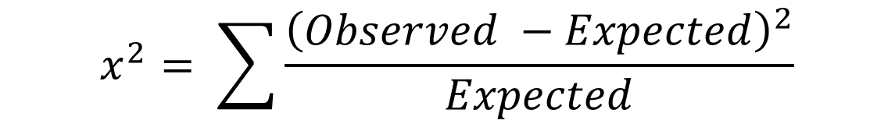
Chi-square test
Test for independence between categorical groups
$$H_{0}:Two categorical variables are independent$$
$$H_{1}:Two categorical variables are not independent$$
$$x^{2}= \sum{\frac{{\left(Observed −Expected\right)}^{2}}{Expected}}$$

Slide 27
Feature Engineering
Feature Creation
Feature Extraction
Feature Scaling
Feature Selection

Slide 28
Feature Creation
Credit length = issue year – earliest credit line year
Installment Feat = monthly installment/monthly income

Slide 29
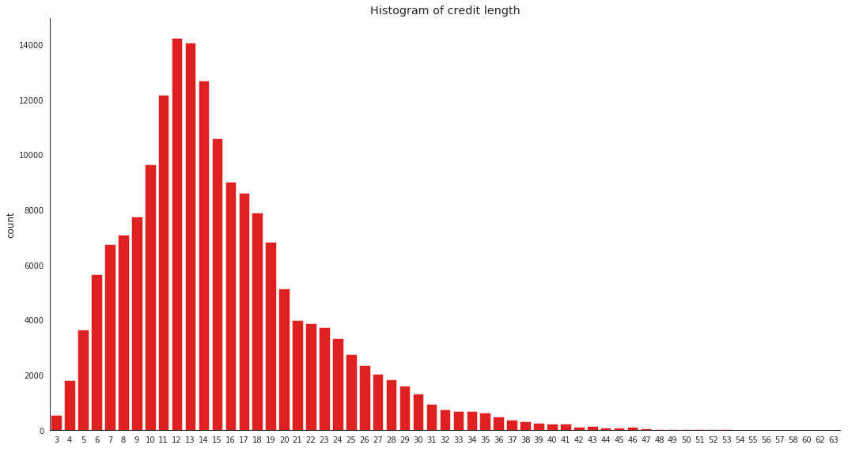
Feature Extraction - Binning
<= 14: coded as 0
> 14: coded as 1
Median Line
Binning (create buckets for variables)
Employment length
Delinquency in last 2 years
Num of derogatory record
Inquiry in last 6 months
Number of open accounts
Etc.

Slide 30
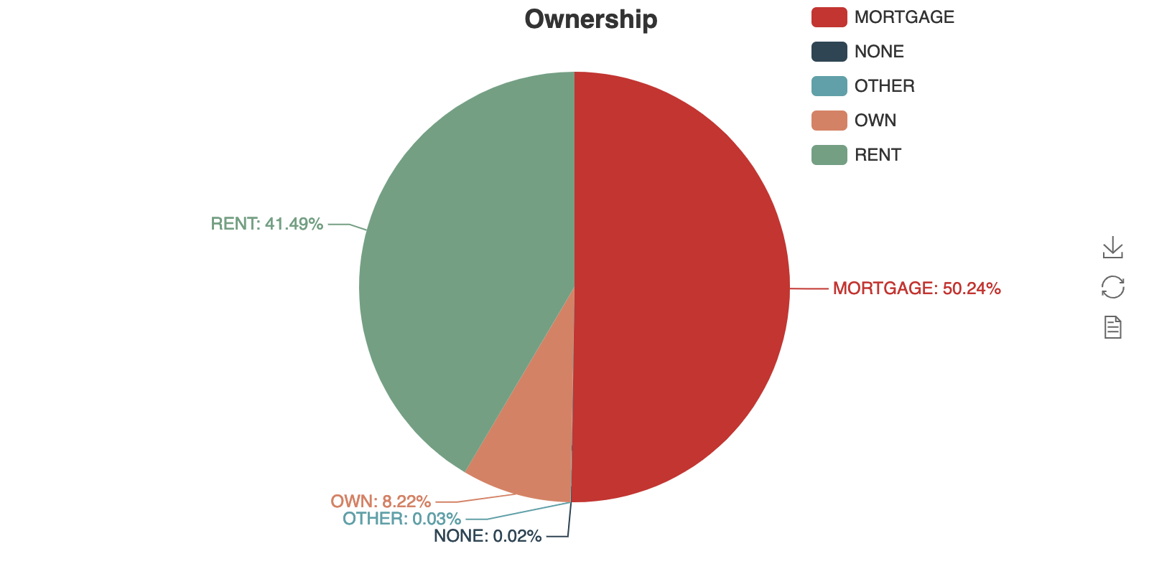
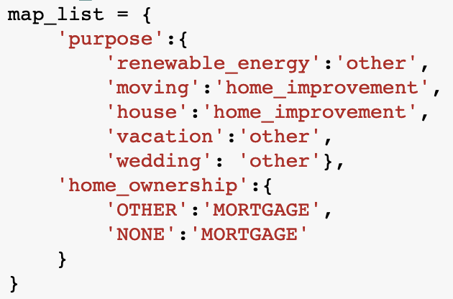
Feature Extraction - Grouping
Group some categories into larger group

Slide 31
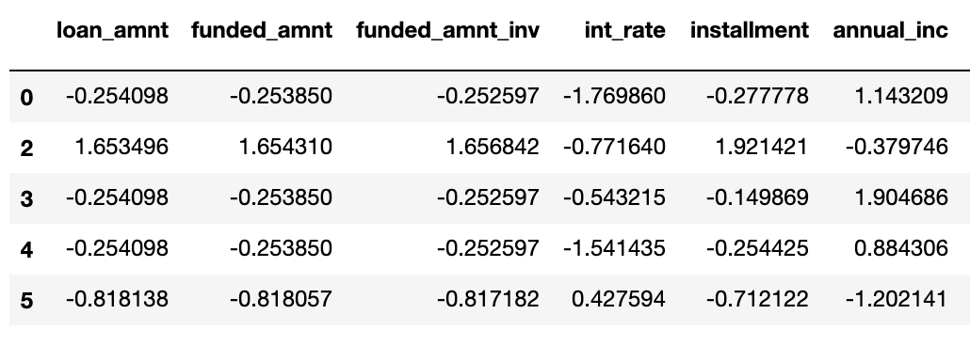
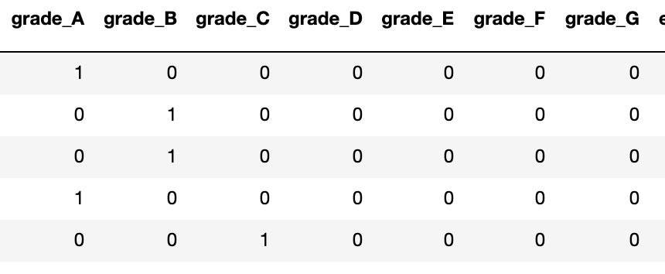
Feature Scaling
Numerical: Standardization
Categorical: Dummy coding

Slide 32
Feature Selection
Filtering Method: Correlation based
Wrapper Method : Recursive Feature Elimination
Embedded: Model based variable selection (Lasso, Random Forest)

Slide 33
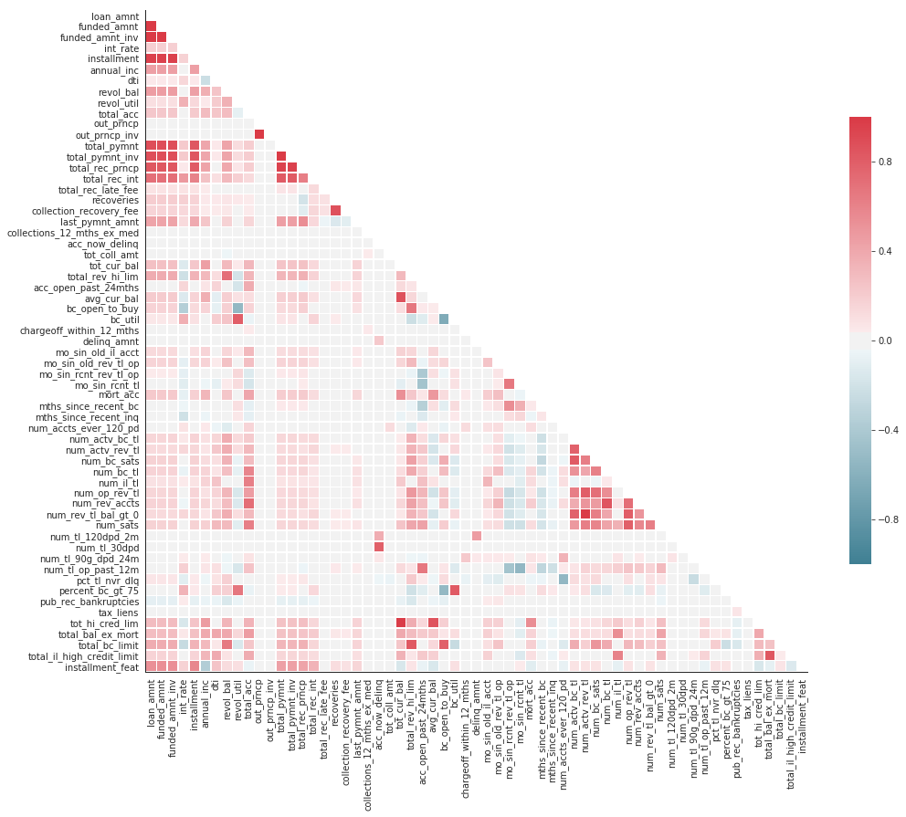
Filtering
Funded Amount, funded
Amount investors, loan amount
almost have correlation of 1
Number of revolving account,
open accounts, satisfactory account, bank account are similar variables

Slide 34
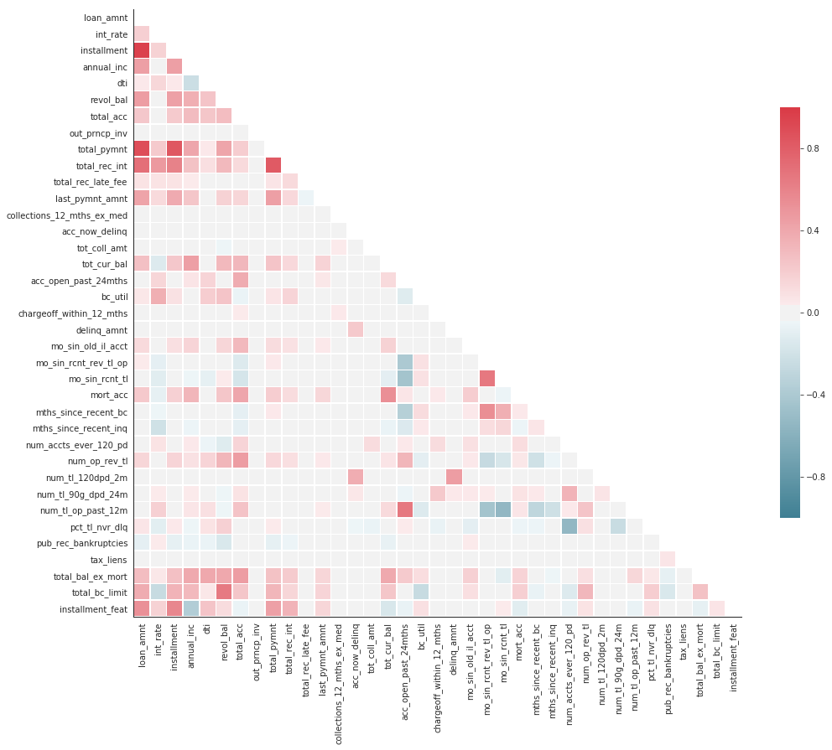
Filtering
Removed 29 variables

Slide 35
Recursive Feature Elimination
Exhaustive
Backward elimination using logistic regression
Eliminate least important features until 30 variables left
Metric: accuracy
Cross-validation to automatically select number of features

Slide 36
Model Building
Train-test split: 80% Training/20% Testing
Model:
Logistic Regression
Decision Tree
Random Forest
Evaluation: ROC Curve/Confusion Matrix

Slide 37
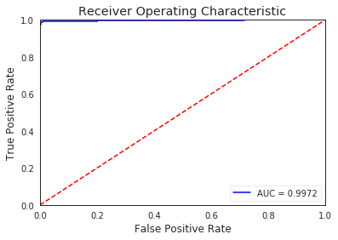
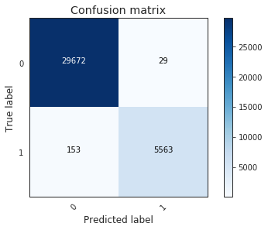
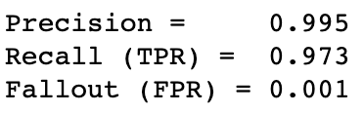
Logistic Regression
Threshold: 0.2

Slide 38
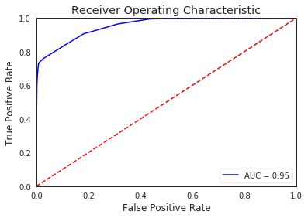
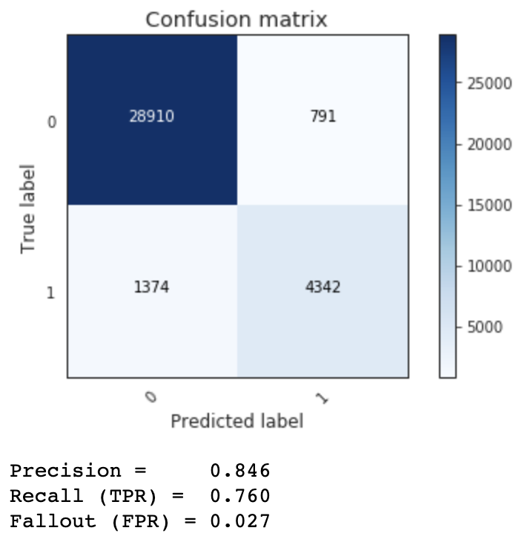
Decision Tree
Threshold: 0.2

Slide 39
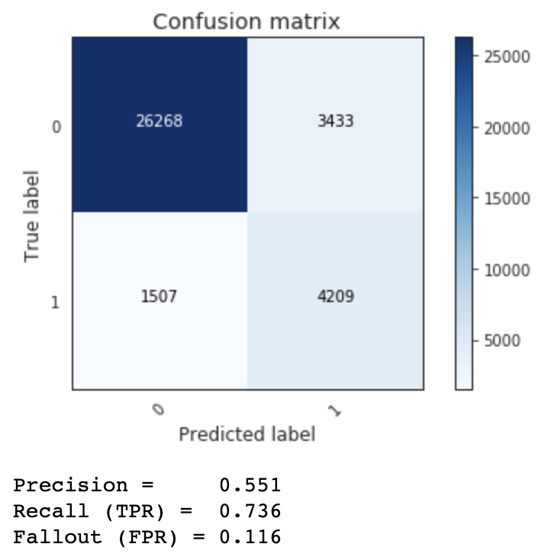
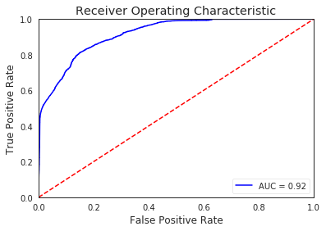
Random Forest
Threshold: 0.2

Slide 40
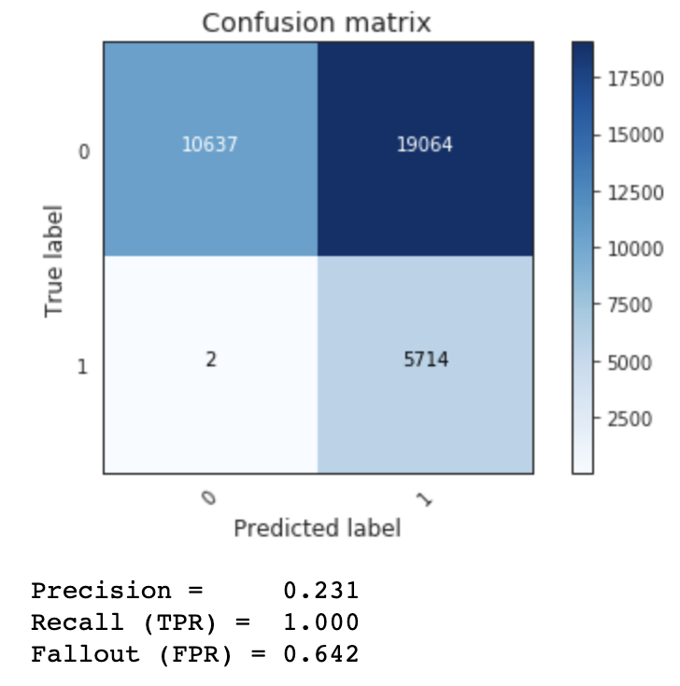
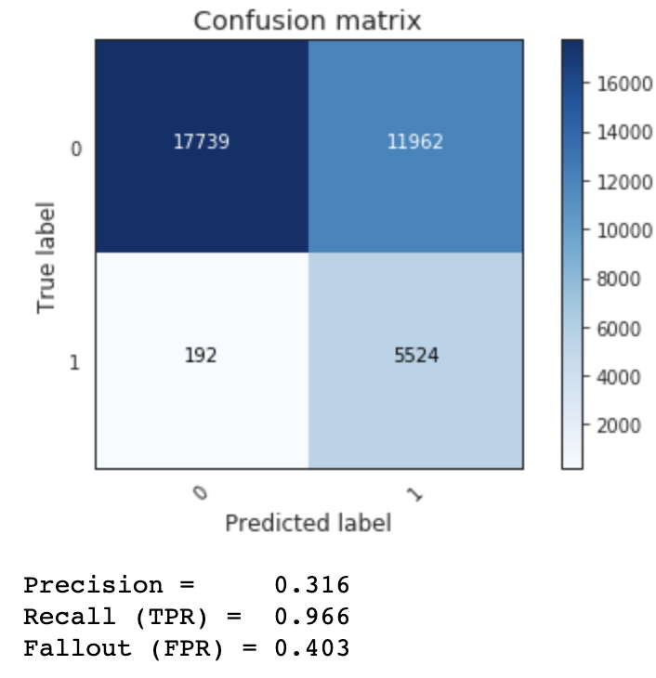
Random Forest
Threshold: 0.1
Threshold: 0.15

Slide 41
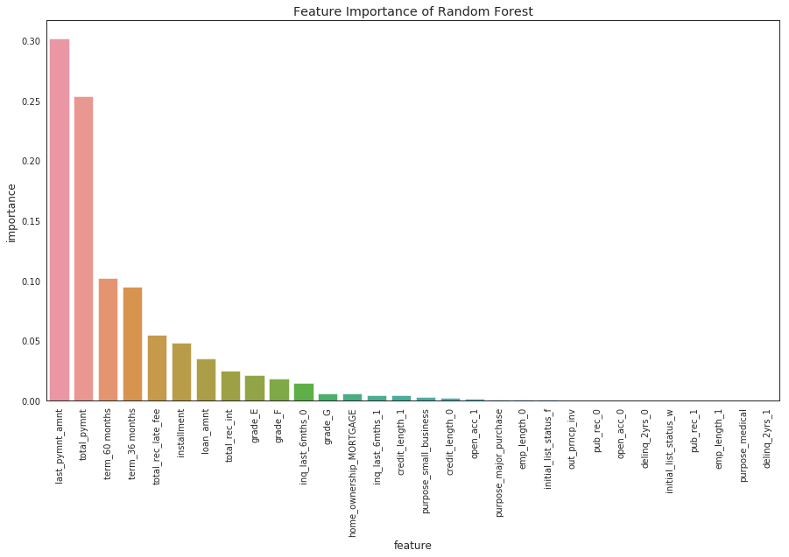
Feature Importance – Gini Index
Important Features:
Last payment amount
Total payment
Term
Total late fees paid
Total Interest paid
Loan amount
Total principal paid
Grade

Slide 42
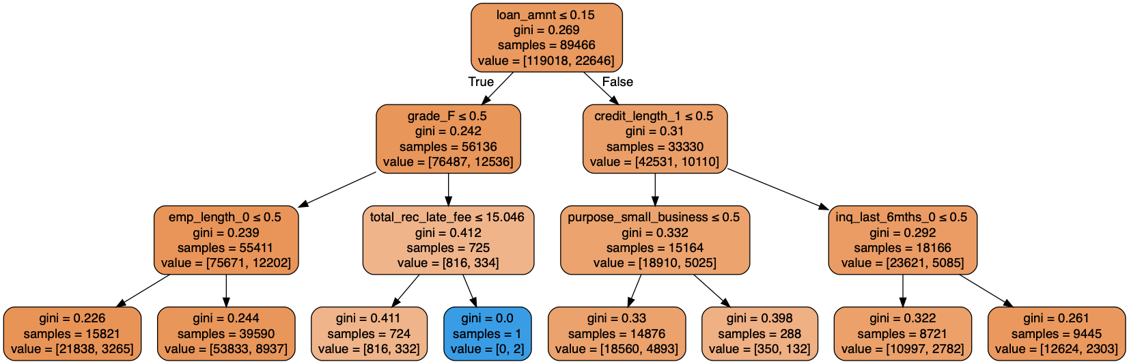
Visualizing Random Forest

Slide 43
Conclusion
In this dataset, all default/non-default cases are completely separated, which leads to good classification result using variables such as ‘total late fees received’.
In reality, most of the customers are ‘current’, the predicting power are likely to decrease
The best result is achieved by Logistic Regression, but needs to be cross-validated before put into production

Slide 44
Recommendation
Recursive Feature Elimination using cross-validation
SMOTE (Oversampling) to deal with unbalanced dataset
Hyperparameter tuning and cross validation
Gather more data, up-to-2018Q4
Analysis on geographic dimension
https://public.tableau.com/views/Book2_15528449246150/Dashboard1?:embed=y&:display_count=yes

Slide 45
Thank you!

